Slide 1
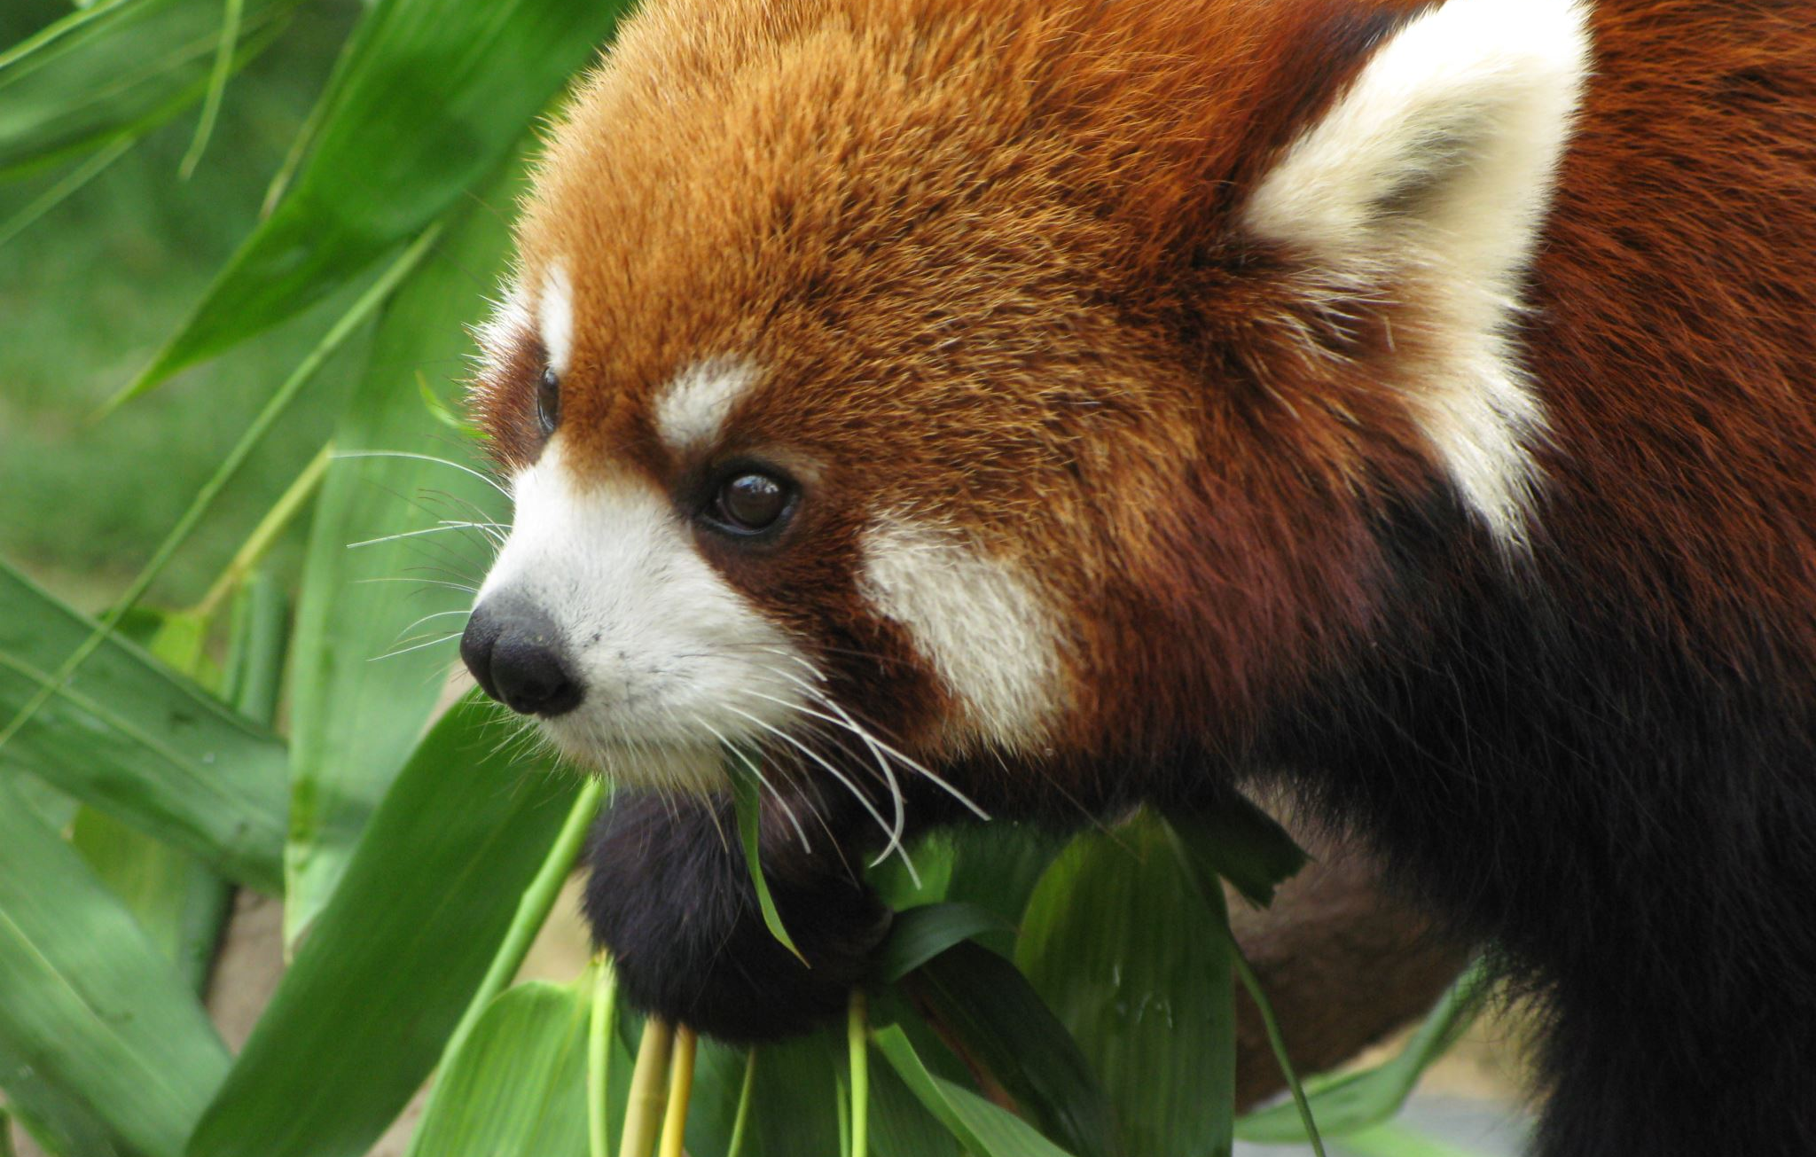
Staff benefits

Slide 2
Working to protect, value and love nature
What’s better than connecting, inspiring, and empowering people and communities to protect, value and love nature…
Making a difference, no matter how small or big, is fundamental to what our people do here at RZSS. Whether you work to engage and excite our visitors by providing excellent 5-star service or work directly with our animals – there’s a role for everyone and we have a fantastic benefits package – just as a little added bonus!

Slide 3
As a Charity first and foremost, we work hard to make sure our benefits package is competitive and attractive. As well as the fundamental benefits like pay, to follow are details of some of the great benefits that can help you financially, can make work a bit easier and make life outside of work a lot more fun!

Slide 4
Culture
Employee Consultative Board (ECB)– have your say! The ECB exists to ensure consultation across RZSS on the broad subject of our terms and conditions of employment. It’s also a great sounding board and forum group to discuss additional matters such as health and wellbeing, employee incentives and employee benefits
Social events – Join a whole range of various extra-curricular social events like quiz nights, crafting, board game events and end-of-season parties – or propose your own through our social committee
Family friendly policies – we offer enhanced paternity, and maternity leave above the statutory minimum in the UK
Flexible working arrangements - We offer a variety of flexible working arrangements where roles allow hybrid or remote working, supported further by part-time options or job sharing

Slide 5
Pay and Pension
Death in Service – Death in Service Insurance is automatically provided to all core employees. Should the worst happen, your family would be provided with financial security, equivalent to 3 times employee’s annual salary
​
Pension – RZSS will automatically enrol employees into a workplace pension (subject to qualifying conditions). You will contribute 4% of your annual salary and RZSS will match your contribution up to a maximum of 5% of your annual salary. If you are not automatically enrolled, you may be eligible to opt in​
​
​
Pay – Through our pay progression framework, you can increase your pay within your existing job role, after you pass your probation
We recognise and reward you based on progression in your personal and professional development - gaining additional knowledge, experience, and skills; demonstrating and applying a heightened level of competence, contribution and impact during your employment with RZSS
Sick pay – Enhanced sick pay arrangements from day one which increases with length of service

Slide 6
leave
Annual leave* – All RZSS employees are either allocated or accrue annual leave up to 34 days. This includes public holidays. The annual leave year runs from 1st January to 31st December
Annual leave buy and sell scheme* – We offer the option to buy and sell annual leave days. You can buy up to five extra days per year and pay us back through salary deductions OR You can sell up to five days per year back to us!
*numbers quoted based on full-time roles. This will be pro-rated to contractual hours.

Slide 7
Health and assistance
Mental Health First Aid – Onsite mental health first aiders who help our people by spotting signs and symptoms of common mental health issues, provide non-judgemental support and reassurance, and guide a person to seek professional support they may need to recover
Employee Assistance Programme - 24/7 helpline offers practical information and emotional support for issues from bereavement to debt support
Our health cash plan* – provided by Health Shield – offers a wide range of positive healthcare benefits, including cash back to cover costs such as dental and optical bills, physiotherapy, flu jabs and even consultancy charges
Monthly cover arrangements includes support for all dependent children
*Available to core staff members only. Excludes those on Casual/seasonal/variable hour contracts.

Slide 8
Health PLAN
My Counselling – 24/7 Counselling and Support Helpline providing guidance and counselling on matters from family to finance
SkinVision - With this personalised skin cancer detection and health advisor, members can self-examine for signs of skin cancer from the comfort of their own home
My Gym Discounts - with savings on gym memberships at over 3,600 locations across the UK, and discounts on a variety of digital fitness subscriptions
My Wellness – a resource hub where you can find tools to help manage your health and wellbeing including;
My PERKS – an exclusive rewards scheme that gives you discounts and money back on everything from fashion, holidays, entertainment, car hire, health and beauty and even weekly shopping from major supermarkets
My GP – Speak to a GP over the phone 24/7 at a prearranged time to suit you, plus you can have a face-to-face video chat on weekdays from your mobile, tablet or laptop
*Available to core staff members only. Excludes those on Casual/seasonal/variable hour contracts.

Slide 9
LEARNING AND DEVELOPMENT
We invest in your learning and development with training programmes, courses and conferences and monitor progress, objectives and development through our annual online performance management system (PABLO).
Professional subscriptions – We believe in your continuous professional development and pay for your annual subscriptions for relevant professional bodies, e.g. CIPD.
E-learning - extensive library of accredited, high-quality courses, including workplace health and safety, HR, compliance and soft skills training.
Exceeding Visitor Expectations – this has been created and crafted to equip team members with the specialist skills and insights they need to deliver the very highest standards of service – ensuring every visitor enjoys a truly outstanding experience.
Individual Development Award – The IDA is another way in which we can support,. encourage and enable individuals to engage and participate in additional development opportunities in the form of focused COMMUNITY, ENGAGEMENT, and CONSERVATION projects or continuous professional development (CPD).

Slide 10
Staff discounts - onsite
We all love a bargain, and we have lots of discount offers here at RZSS:
  Free/discounted Access – You will receive a staff membership which will give you (and family/friends) free (and discounted) entry to both Edinburgh Zoo and the Highland Wildlife Park as well as a number of Zoo’s across the UK
​ASVA Passes – Use of ASVA passes which provides free access to a whole host of other Scottish attractions through Association of Scottish Visitor Attractions (ASVA)​​
Staff restaurant discounts – Up to 50% discount available in the staff restaurant as well as the public eateries and snack bars.
Retail discounts – Get up to 25% discount available in our retail shops for all those essential purchases.

Slide 11
extras
Car parking – Free parking is available for staff on the Edinburgh Zoo site and Highland Wildlife Park site
*Access to discounted gym membership –
Highland Highlife – 20% discount on the standard cost of an individual or family membership
Spirt health club – Discounted membership
*Starbucks (EZ Only) - RZZS employees get a 25% discount off the food & drink bill at Starbucks Cafe at Holiday Inn Edinburgh Hotel
Bike to Work scheme – RZSS is currently part of the ‘Bike to Work Scheme’ in partnership with the Edinburgh Bicycle Cooperative. The scheme offers tax incentives that enable staff to enjoy serious savings on the price of a new bicycle
*These are not formal employment benefits but rather arrangements to get some discount or other offers not normally accessible.
These perks may over time change, be added to or even ended. Also, please note that such arrangements are not an endorsement of the organisation (or its products/services), and so their use is at the sole discretion of each individual who chooses to utilise the perk.

